Slide 1
NERSC Training Accounts
for JULIA FOR HPC AND INTRO TO JULIA FOR SCIENCE

Slide 2
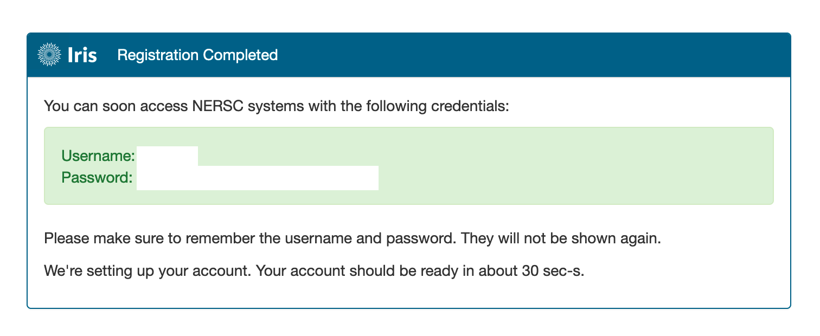
Activate your Training Account
Go to: https://iris.nersc.gov/train
Enter the Training Code: “ejZ5” along with your details Note: if you have previously registered an account using a different code please recreate it.
Important: make a copy of your login and password you won’t be able to change these, nor recover them later!!!

Slide 3
Access to Perlmutter and Use Julia Module
NERSC users have been added to ntrain9 project
Non-users were sent the instruction to get a training account
Account valid through June 23
Login to Perlmutter: ssh username@perlmutter.nersc.gov
Julia modules:
% module use /global/common/software/nersc/julia_hpc_24/modules/
% module use /global/common/software/nersc/n9/julia/modules
% module load PrgEnv-gnu cray-hdf5-parallel
% module load adios2 julia
Running Jobs examples:
https://docs.nersc.gov/jobs/

Slide 4
Compute Node Reservations
GPU node reservation: 1pm - 4pm EDT, Tues June 18
To use 1 GPU only (sample flags for sbatch or salloc):
-A ntrain1 --reservation=julia_hpc_18 -C gpu -N 1 -c 32 -G 1 -t 30:00 -q shared
To use multiple nodes (sample flags for sbatch or salloc):
-A ntrain1 --reservation=julia_hpc_18 -C gpu -N 2 -t 30:00 -q regular
Outside of reservation, use:
To use 1 GPU only (sample flags for sbatch or salloc):
-A <project> -C gpu -N 1 -c 32 -G 1 -t 30:00 -q shared
To use multiple nodes (sample flags for sbatch or salloc):
-A <project> -C gpu -N 2 -t 30:00 -q regular (or -q interactive for salloc)

Slide 5
Reminder about file Systems
$HOME is not the best file system for running jobs at scale. Consider therefore replacing all occurrences of $HOME with $SCRATCH in the NERSC scripts here:
https://github.com/JuliaORNL/GrayScott.jl/tree/GrayScott-JACC/scripts
Pro tip: add export JULIA_DEPOT_PATH=$SCRATCH/depot to you scripts for optimal performance (remember to do this in the config script, and the job scrip)

Slide 6
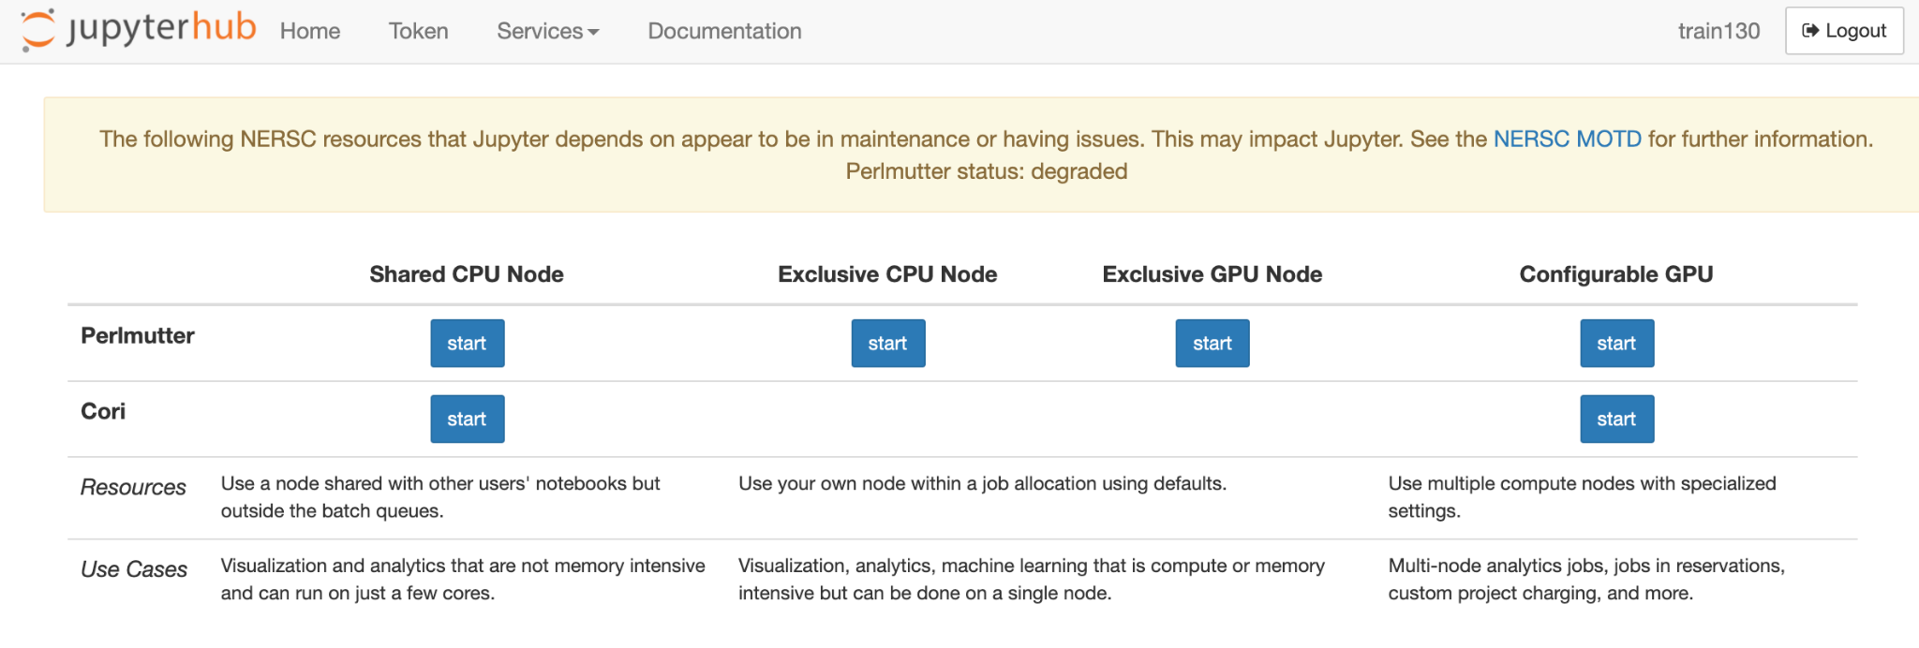
Logging into Jupyter
Go to https://jupyter.nersc.gov
Sign in using your training account credentials
Select your preferred jupyter instance:

Slide 7
Setup
Go to https://jupyter.nersc.gov and select: “Exclusive GPU Node” in the “Perlmutter” row

Slide 8
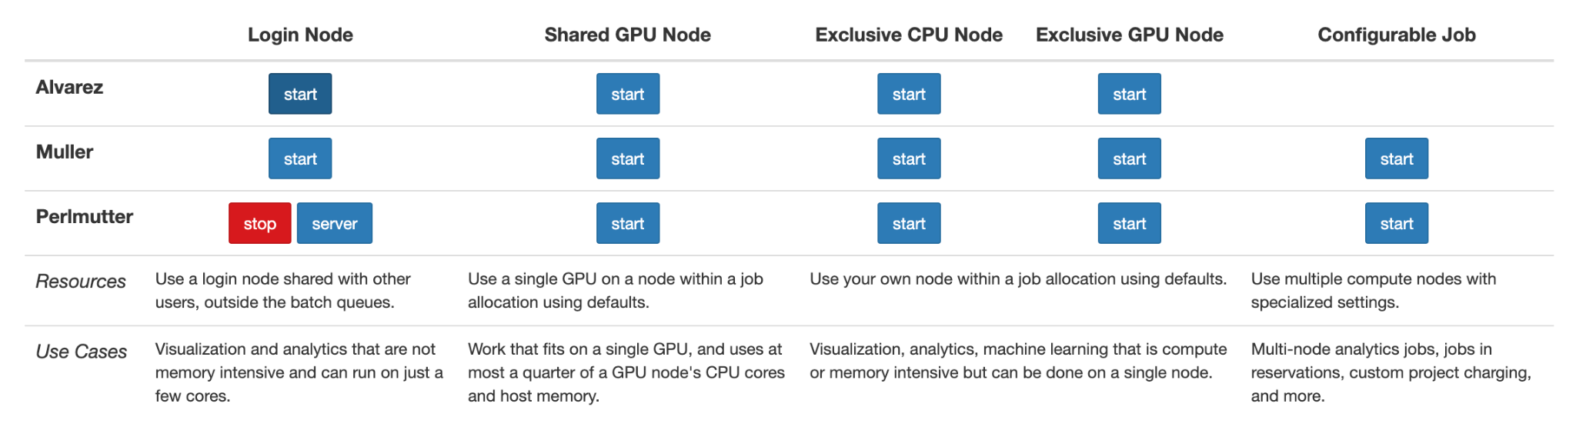
Setup
If you’re spending a long time in the queue waiting for an exclusive GPU node, “Shared GPU Node”s are also available – eg:
Alternatively please use a reservation (details later)
Go to https://jupyter.nersc.gov and select: “Exclusive GPU Node” in the “Perlmutter” row

Slide 9
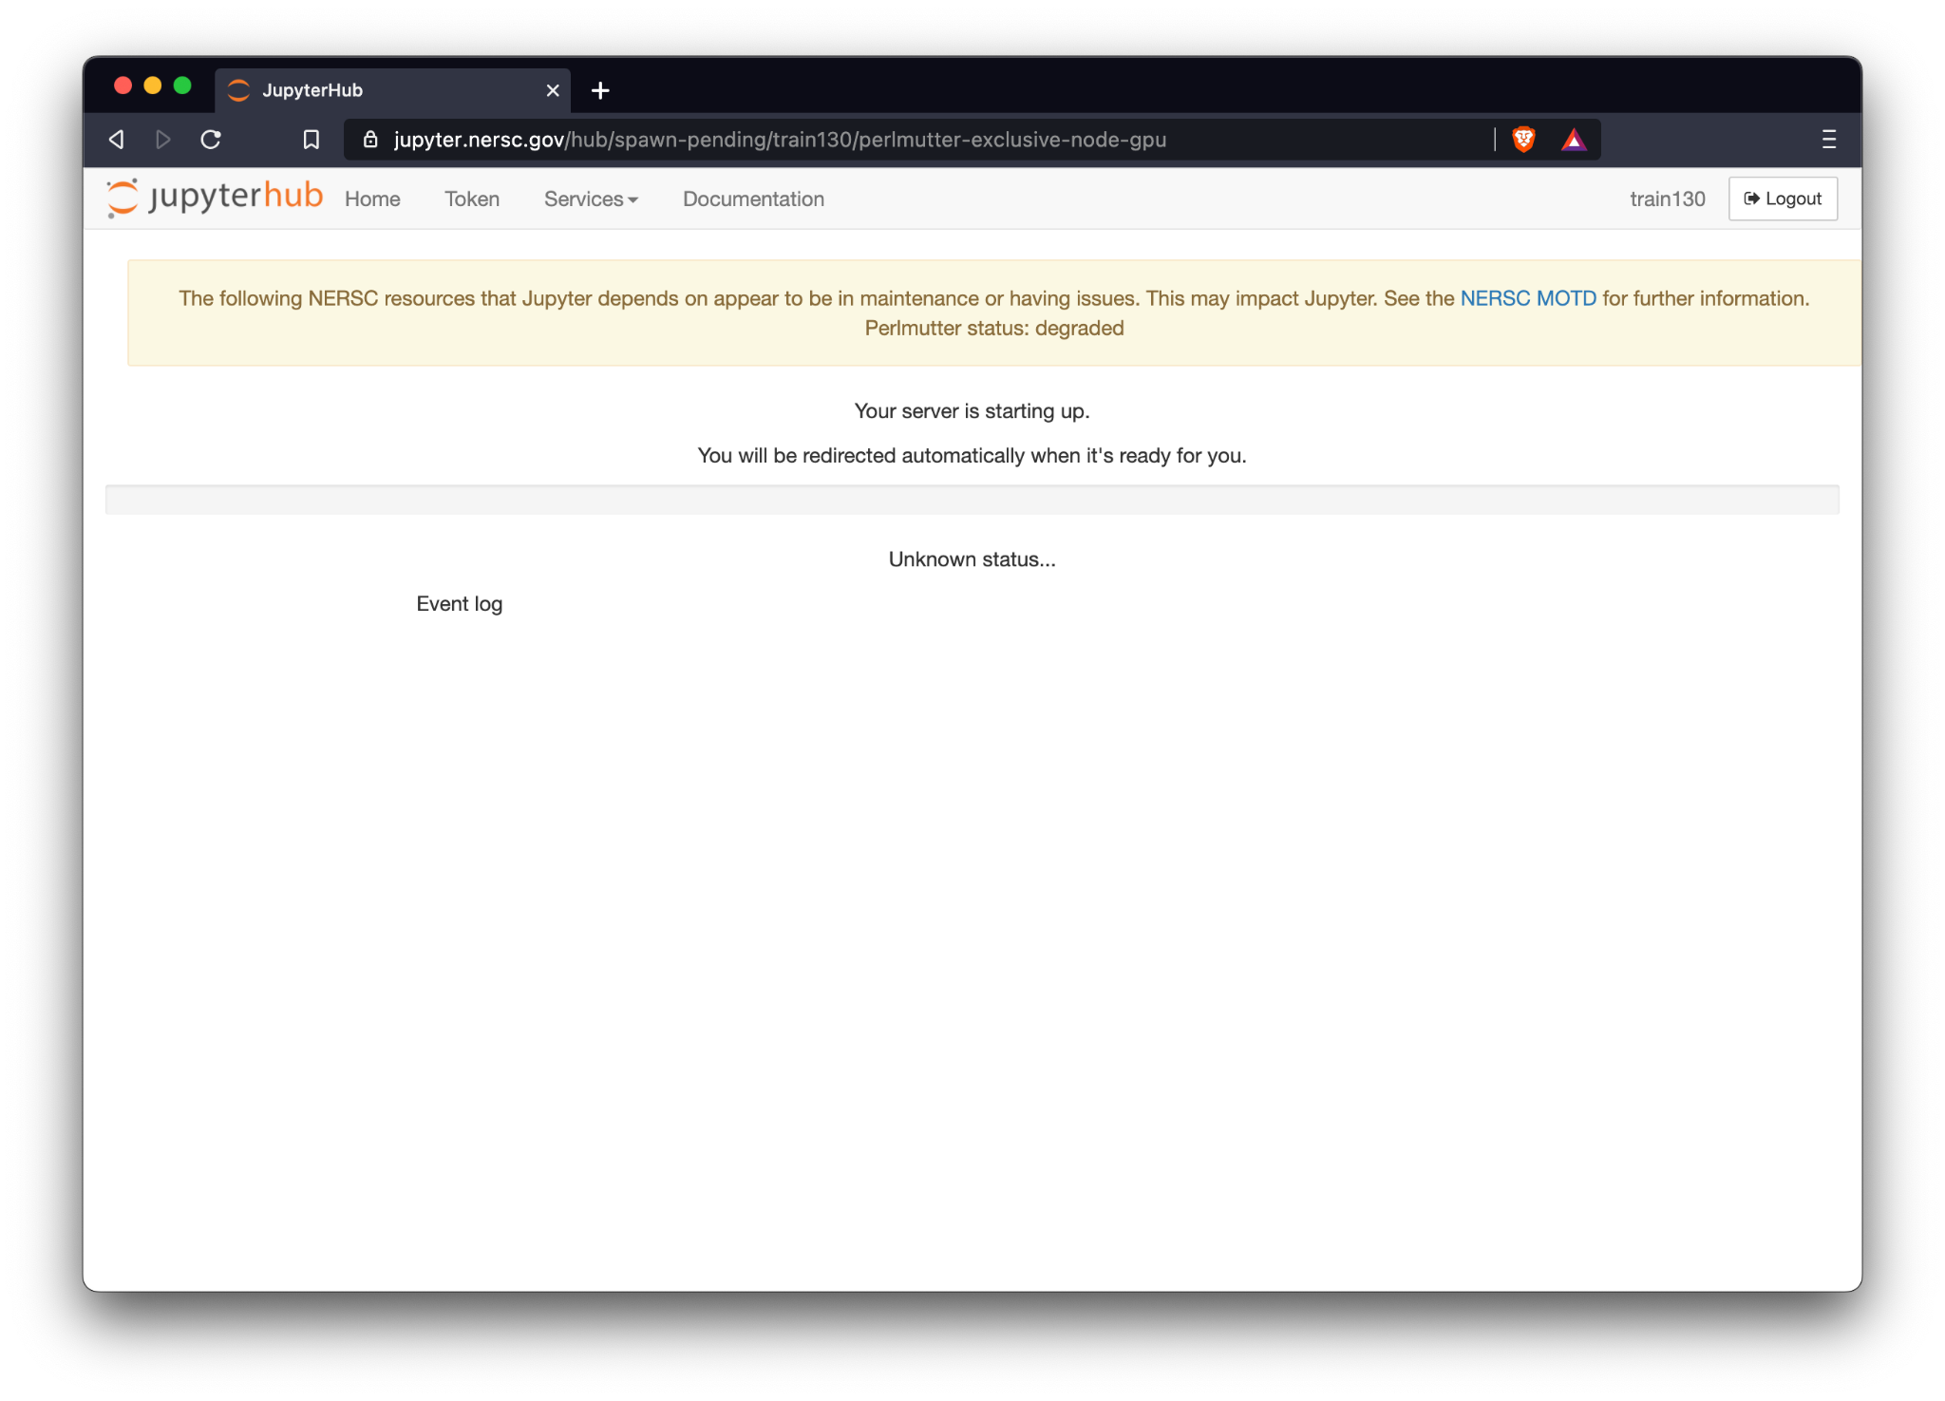
Setup
Jupyter should take a minute to start:

Slide 10
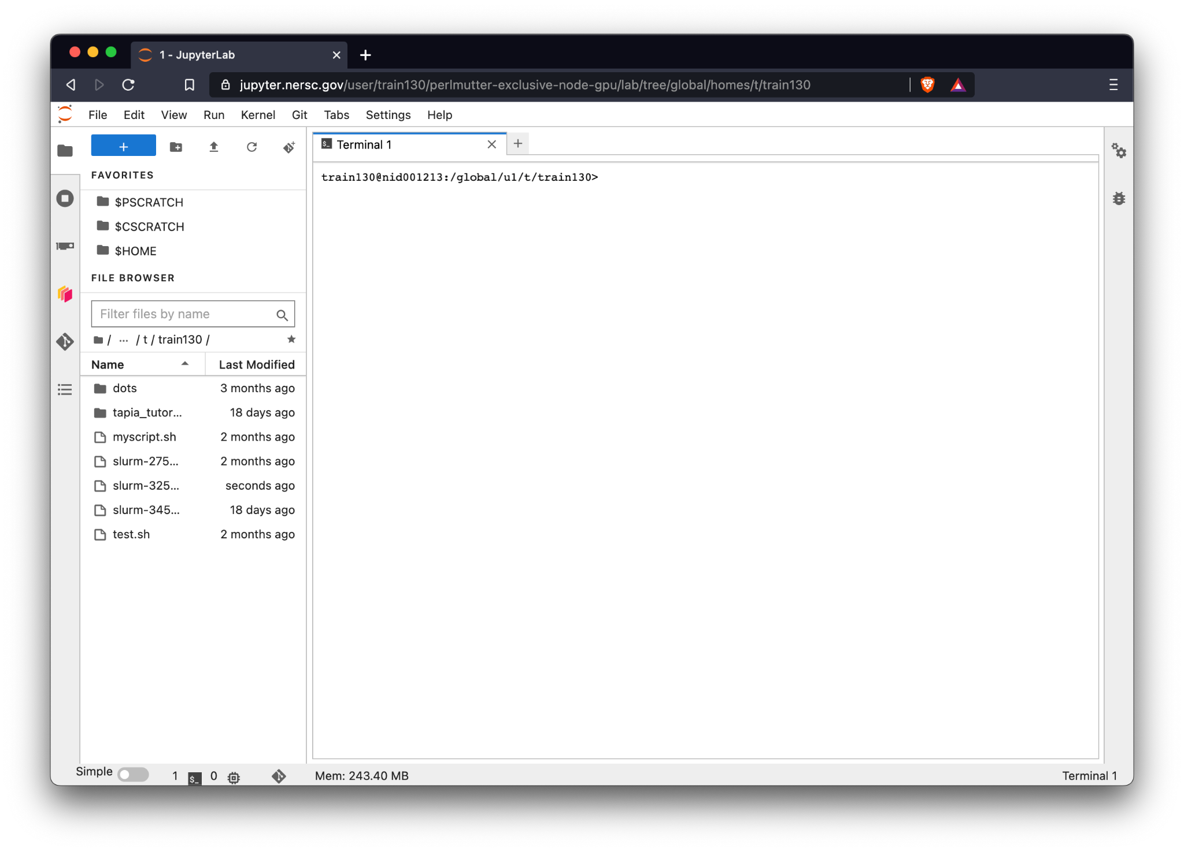
Setup
Once started you should see a terminal

Slide 11
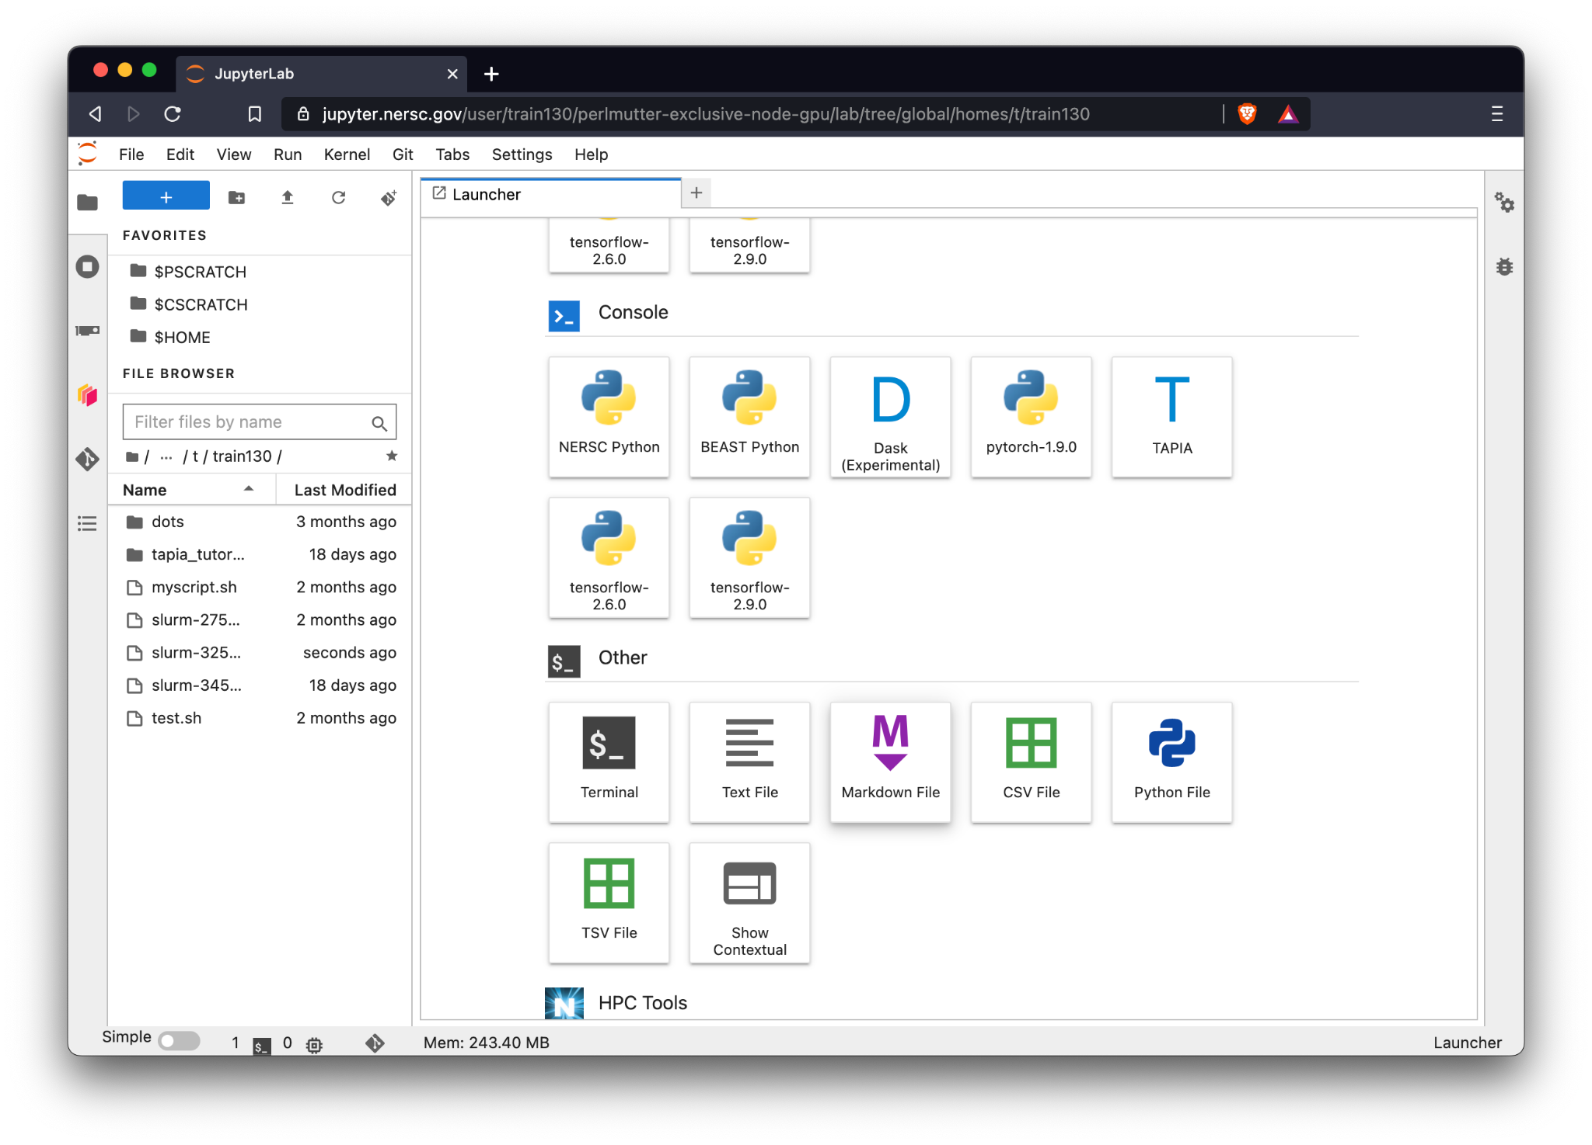
Setup
(If you don’t see a terminal), select “+” followed by “Terminal”

Slide 12
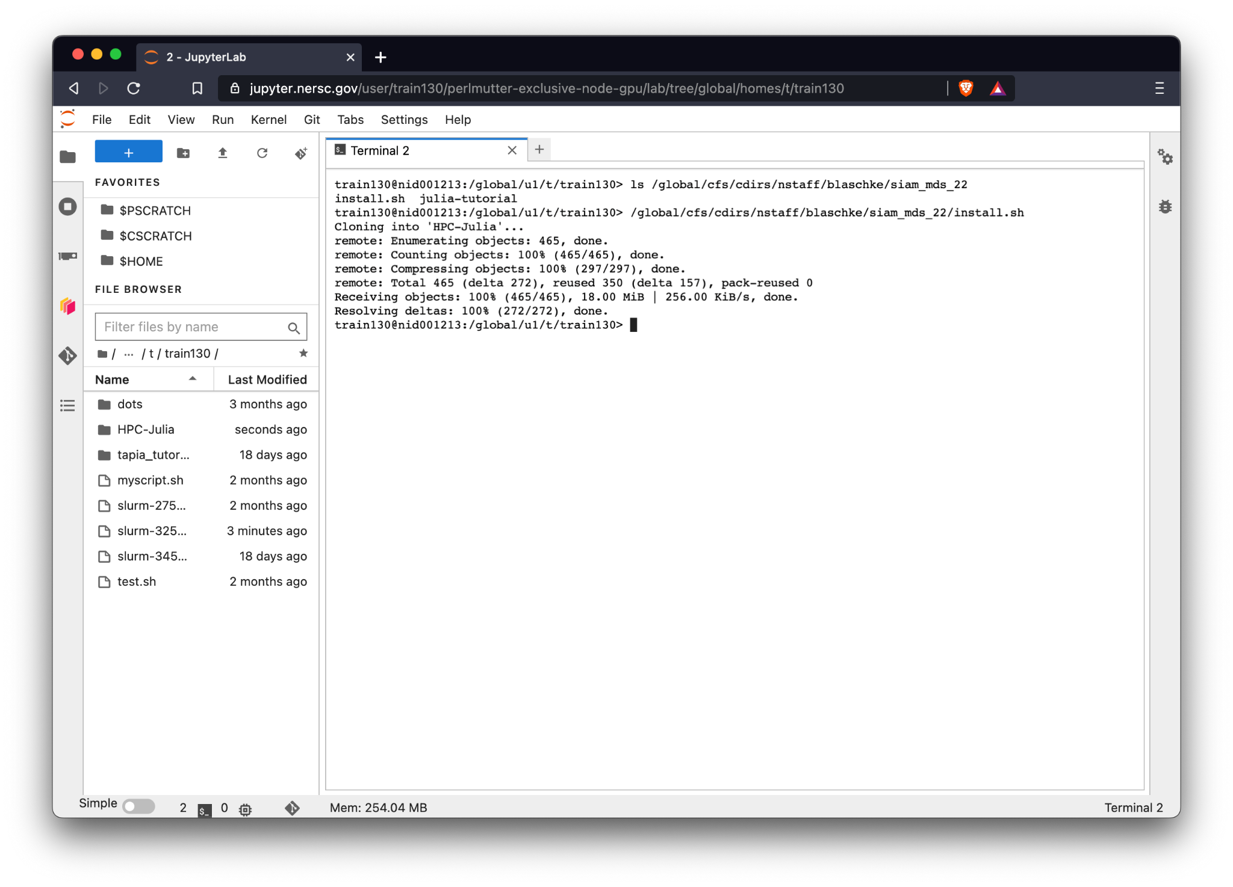
Setup
(In the terminal), follow William’s installation instructions

Slide 13
Setup
(In the terminal), follow William’s installation instructions
NERSC Julia Kernel install script here:
/global/cfs/cdirs/nstaff/blaschke/olcf_nersc_24/install.sh

Slide 14
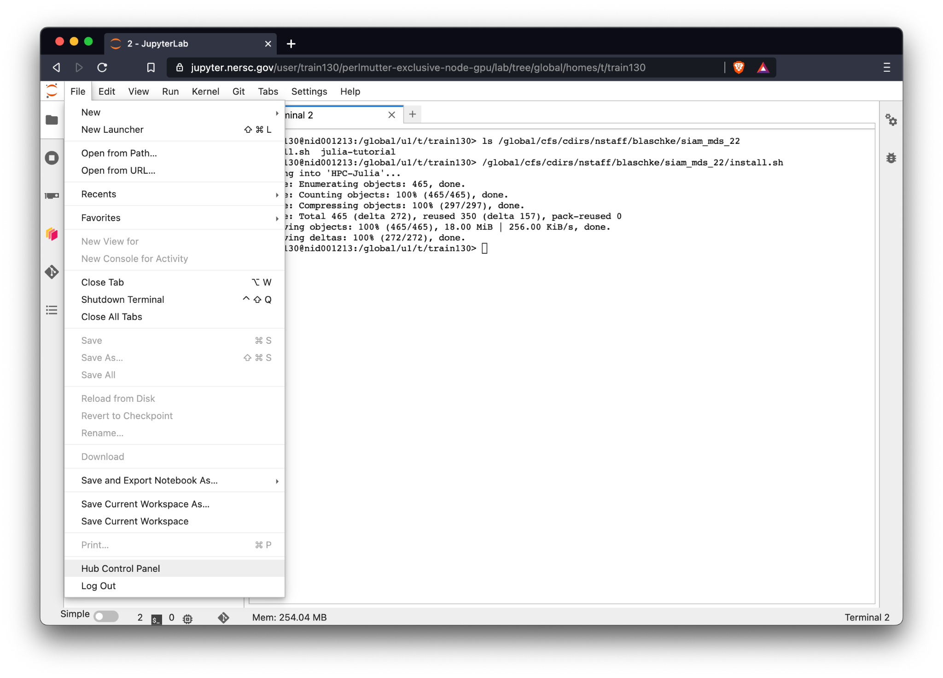
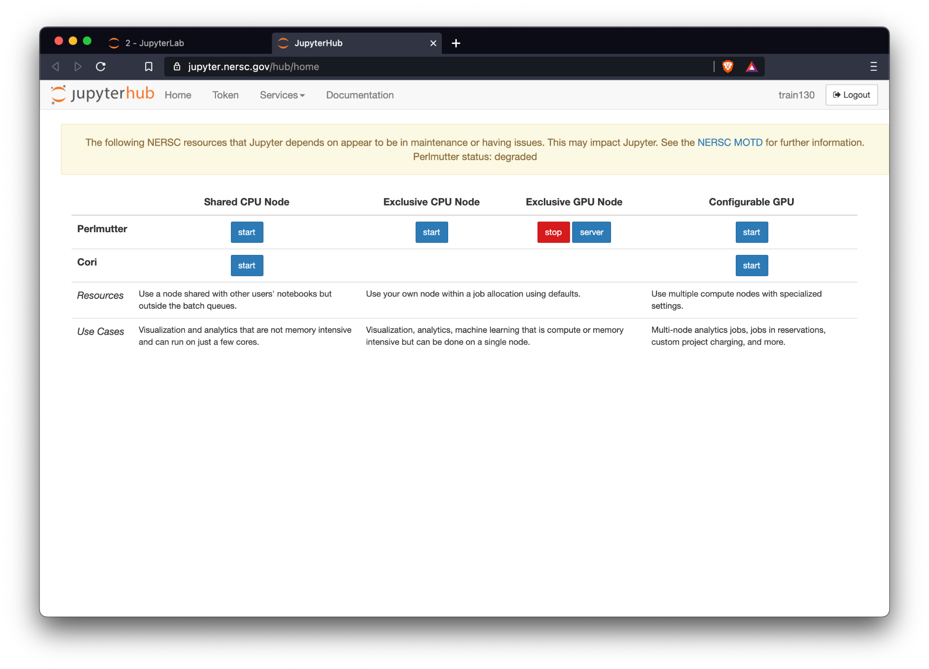
Setup
Stop your server by going to: “File” > “Hub Control Panel”
The selecting “Stop”

Slide 15
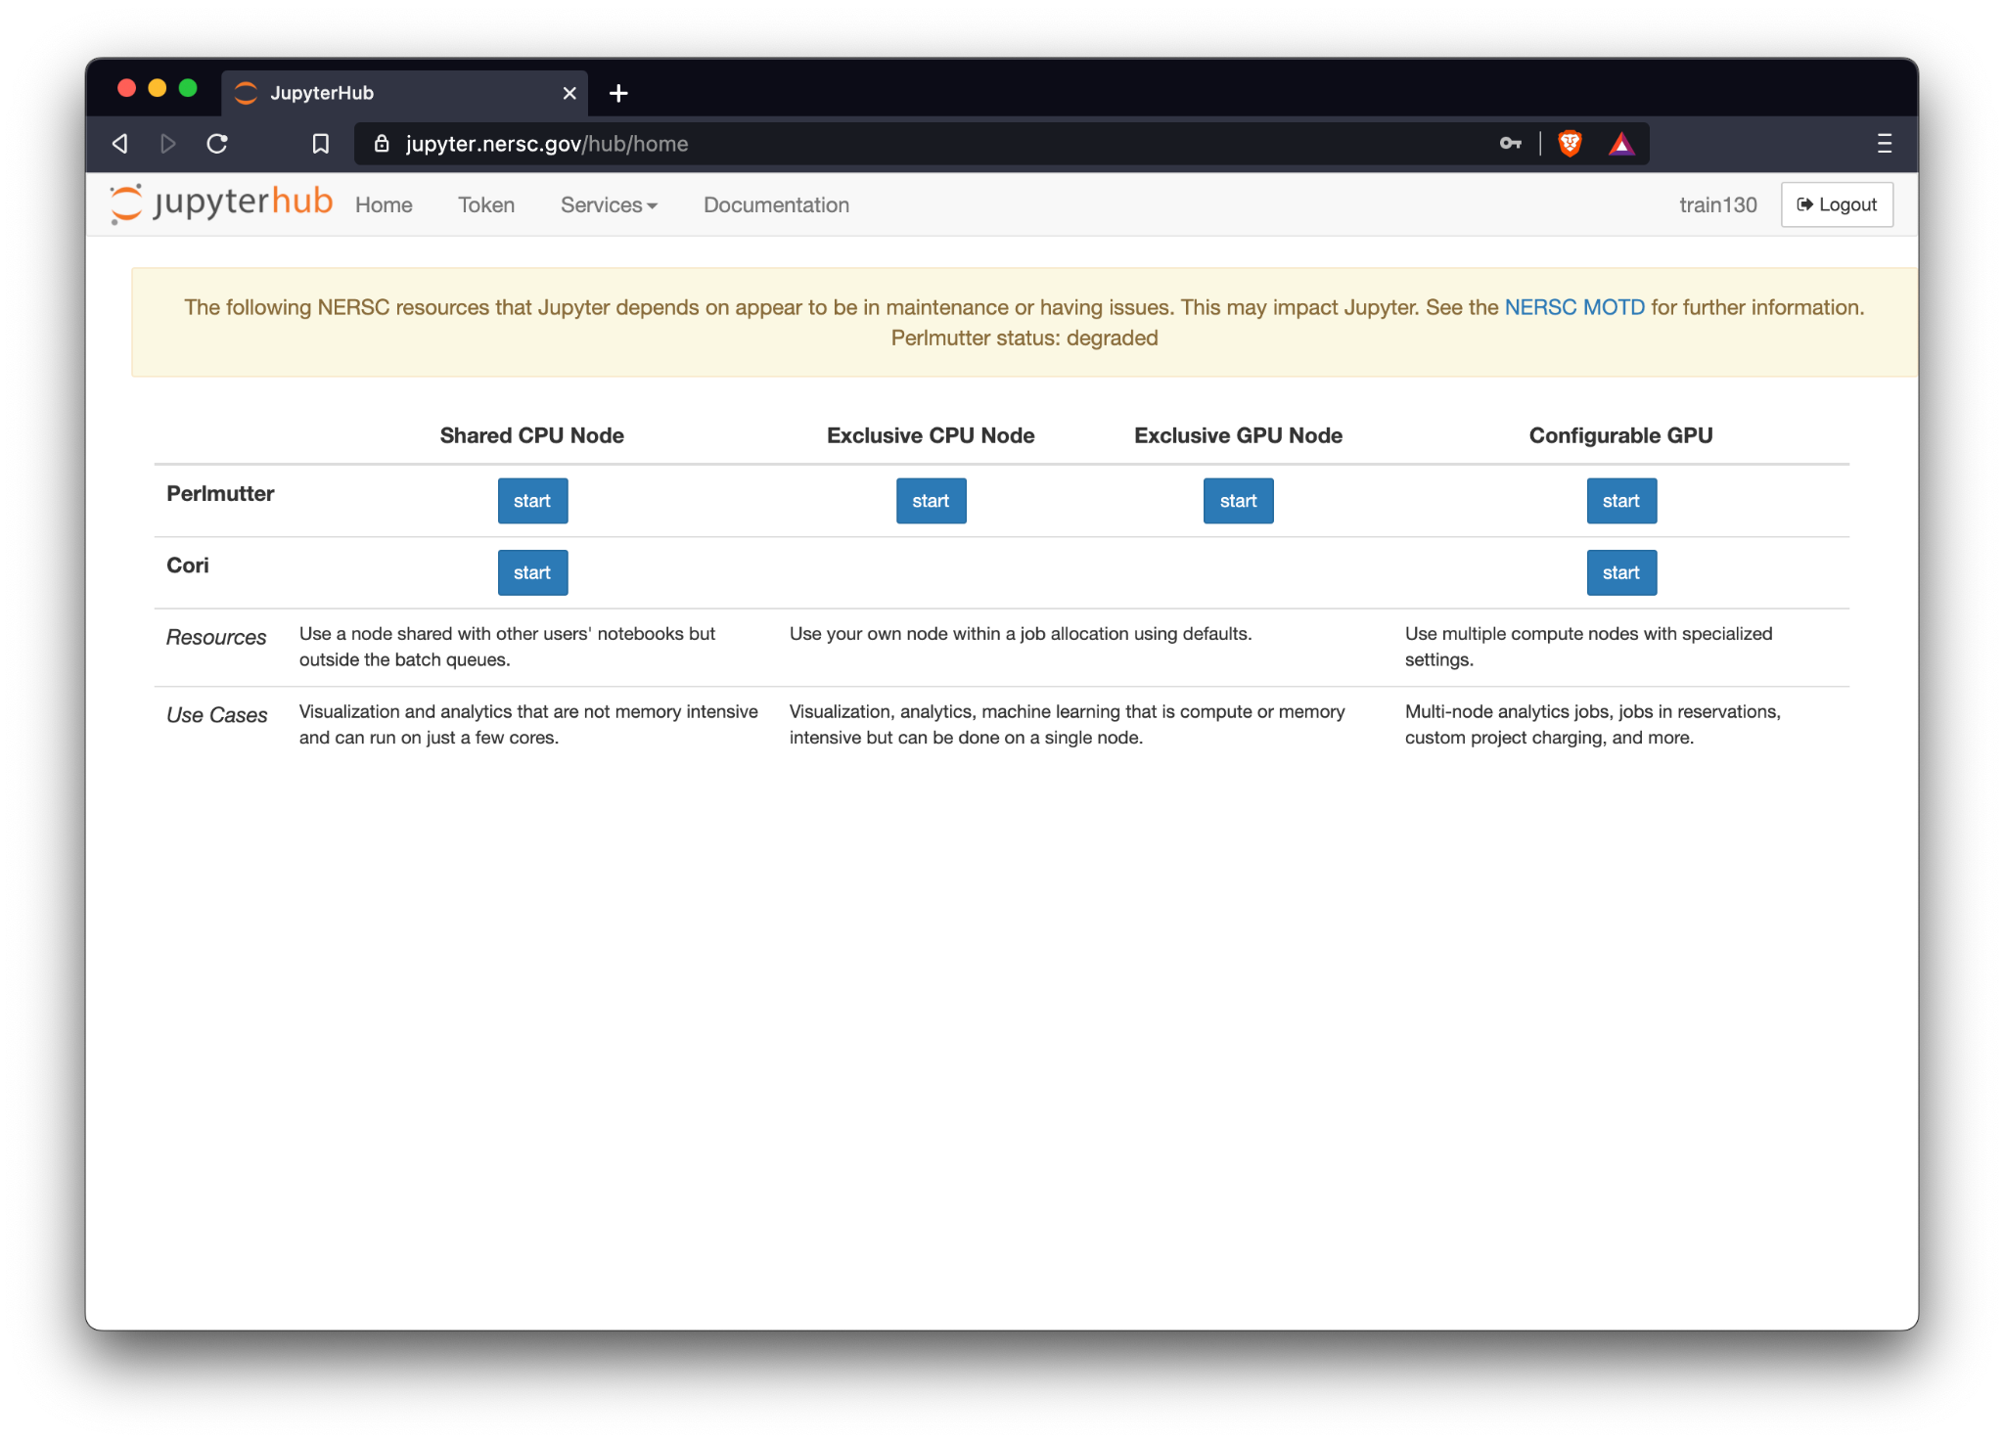
Setup
Start a fresh exclusive node on Perlmutter

Slide 16
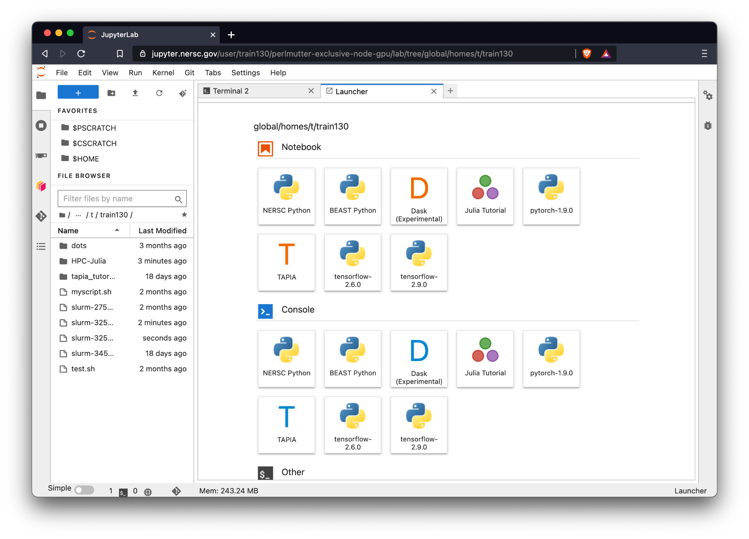
Setup
Select the launcher, you should see the Julia Kernel :)

Slide 17
Using Reservations in Tutorials
Go to https://jupyter.nersc.gov and select: “Configurable GPU” in the “Perlmutter” row

Slide 18
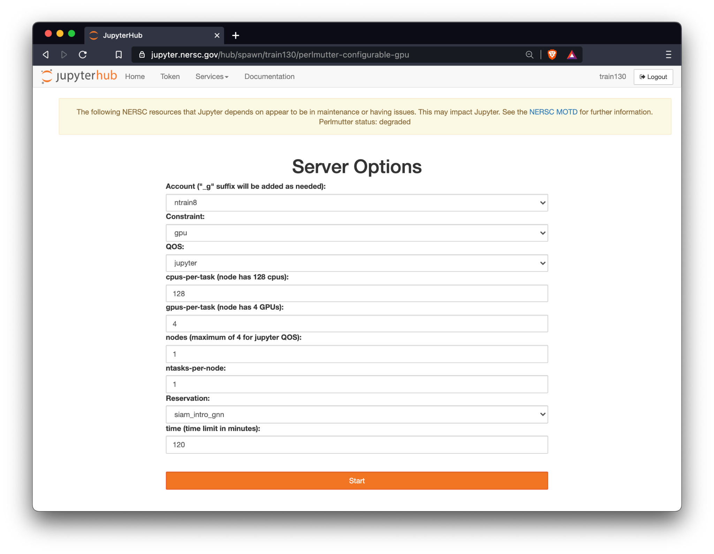
Jupyter Options:
Leave defaults, except:
Account:
ntrain1
Reservation
julia_hpc_18 or julia_hpc_21
Time
120

Slide 19
Note:
Reservations will be available 15 mins before each session and run for 3 hours. If you request a node during this time, make sure that the current time + requested time does not exceed the reservation’s end time.
Training accounts are fully fledged NERSC accounts
Will remain available until Sunday – please copy any data and code to your computer before then

